Slide 1
CSCI 301 Scripting Languages
Presentation
Josh Stradford

Slide 2
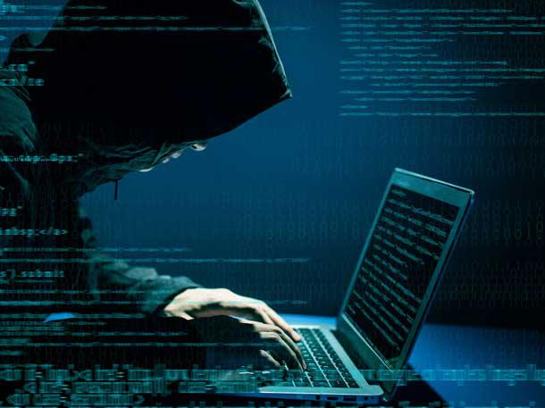
Microsoft Breach January 2021
This incident came to light in January 2021 when a security specialist noticed some anomalous activity on a Microsoft Exchange Server operated by a customer
It was then noticed that there was something odd on the server downloading emails
In one of the largest cyberattacks in US history, over 30,000 US businesses were affected by a sweeping attack on the Microsoft Exchange email servers, one of the largest email servers in the world. The hackers were able to exploit four different zero-day vulnerabilities that allowed them to gain unauthorized access to emails from small businesses to local governments.

Slide 3
What Happened
Technically what happened? It was determined that four zero-day vulnerabilities were allowing unauthorized parties to access data, deploy malware, hijack servers, and access backdoors to reach other systems.
This was more of a software issue because it related to malware and data specific to the software
Customer emails were hacked, and data was leaked and reached by unauthorized parties
Some of the original attacks were traced back to Hafnium, which originates in China. However, with the sheer volume of hacks, it’s likely that multiple groups took advantage of the vulnerability.

Slide 4
What damage did it cause?
Full extent of damage is still unknown to this day.
Acer reportedly suffered data exfiltration and was hit with a demand to pay a ransom of $50 million. Acer, however, did not comment on the incident, nor on the size of the ransom demanded
Over 30,000 companies were impacted nationally and over 60,000 companies world-wide.

Slide 5
How could it be prevented?
It has been said that Microsoft at that time operated in an “old school” approach by thinking that hot patches can resolve the issues.
Vulnerability and Compliance Management
  Helps you identify the gaps, weaknesses, and security misconfigurations within your physical and virtual environments.
Update software regularly.
Use encryption technology
  Proven way to prevent cyber attacks. Over 73% of attacks since 2013 would have prevented if encryption technology was used.
Conduct cybersecurity training for employees, contractors and partners
They were ultimately able to patch the issue, but they could not have done it without the tips listed above.

Slide 6
Sources
https://www.360coveragepros.com/cyber-security-compliance/8-tips-to-prevent-data-breaches
https://firewalltimes.com/microsoft-data-breach-timeline/
https://securityboulevard.com/2021/12/what-we-can-learn-from-the-2021-microsoft-data-breach/
https://cyberlaw.ccdcoe.org/wiki/Microsoft_Exchange_Server_data_breach_(2021)
https://cipher.com/blog/5-effective-ways-to-prevent-data-breaches/

